Slide 1
Tenets of Good Podcasting
By Michael O’Connell
Images by Shutterstock
Presentation Copyright 2017 by Michael O’Connell

Slide 2
Have a passion for the topic.

Slide 3
A podcast is a promise. Post on time.

Slide 4
Does your audience listen to podcasts?

Slide 5
Do the work.

Slide 6
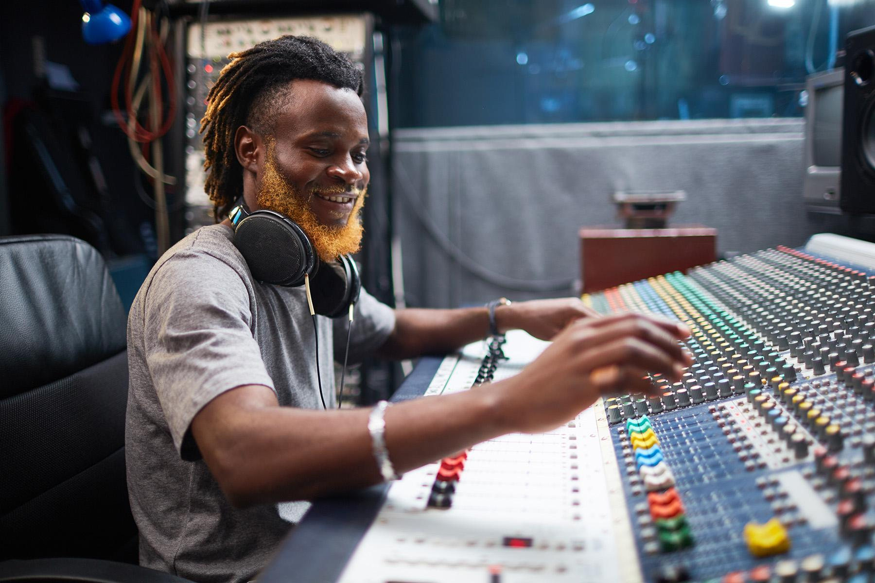
Solve your technical
problems early.

Slide 7
A podcast is not reality.

Slide 8
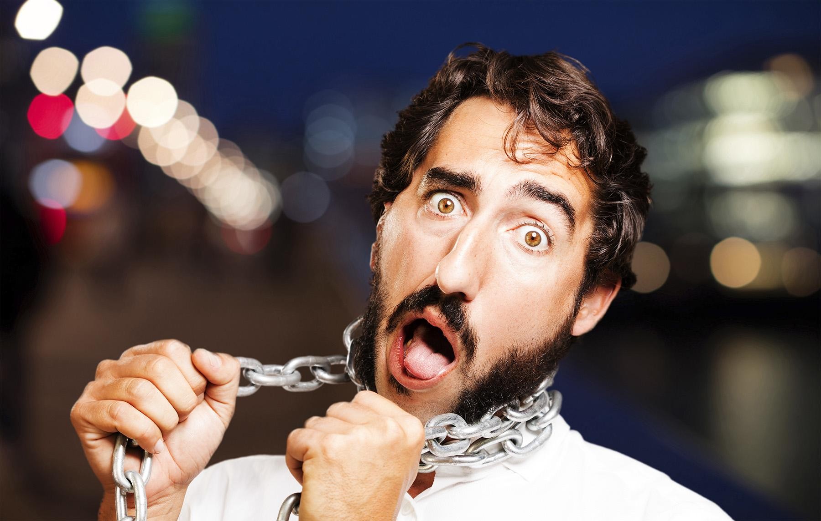
Structure does not equal shackles.

Slide 9
Develop a podcasting identity.

Slide 10
Imagine the person you’re talking to and talk to them.

Slide 11
Learn when to shut up.

Slide 12
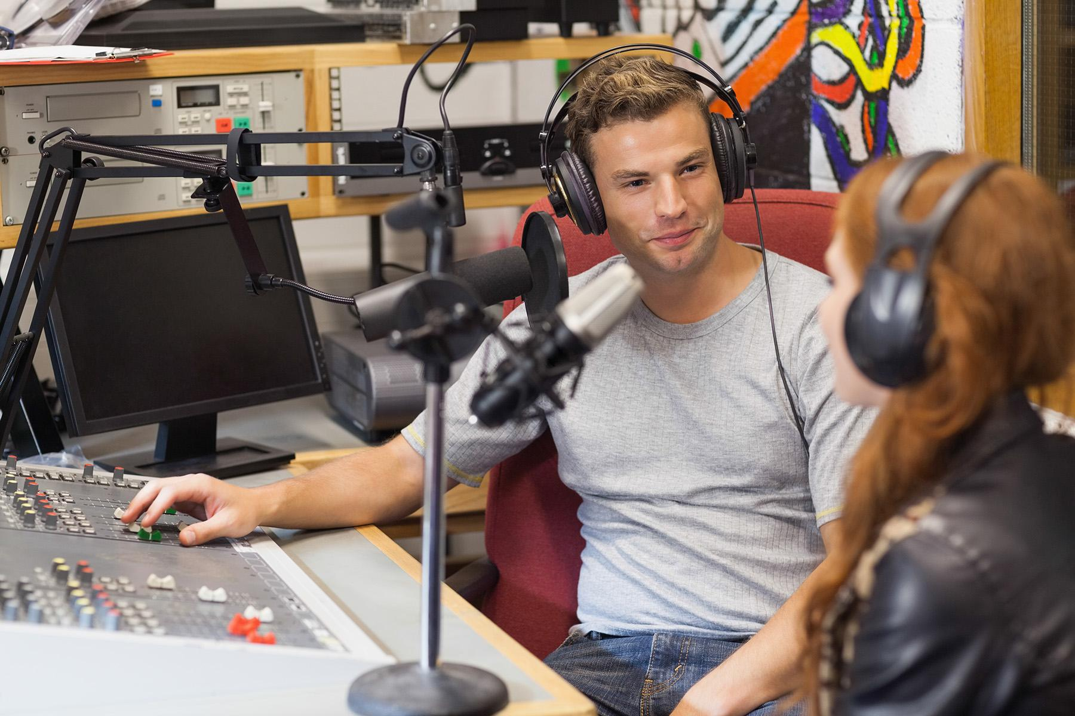
Listen and react, but don’t restate.

Slide 13
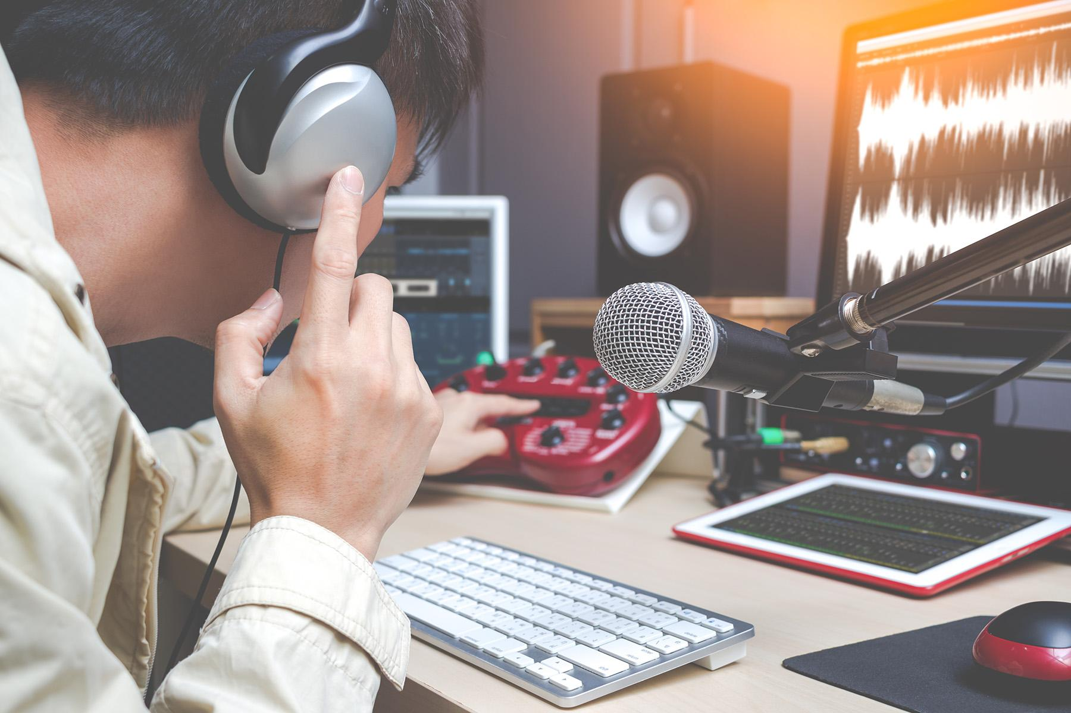
Pre-production is just as important as post-production.

Slide 14
Put your guest at ease.

Slide 15
Seek diversity in guests and topics

Slide 16
Learn to take criticism.
Learn to take criticism.

Slide 17
Figure out how to pay for this thing.

Slide 18
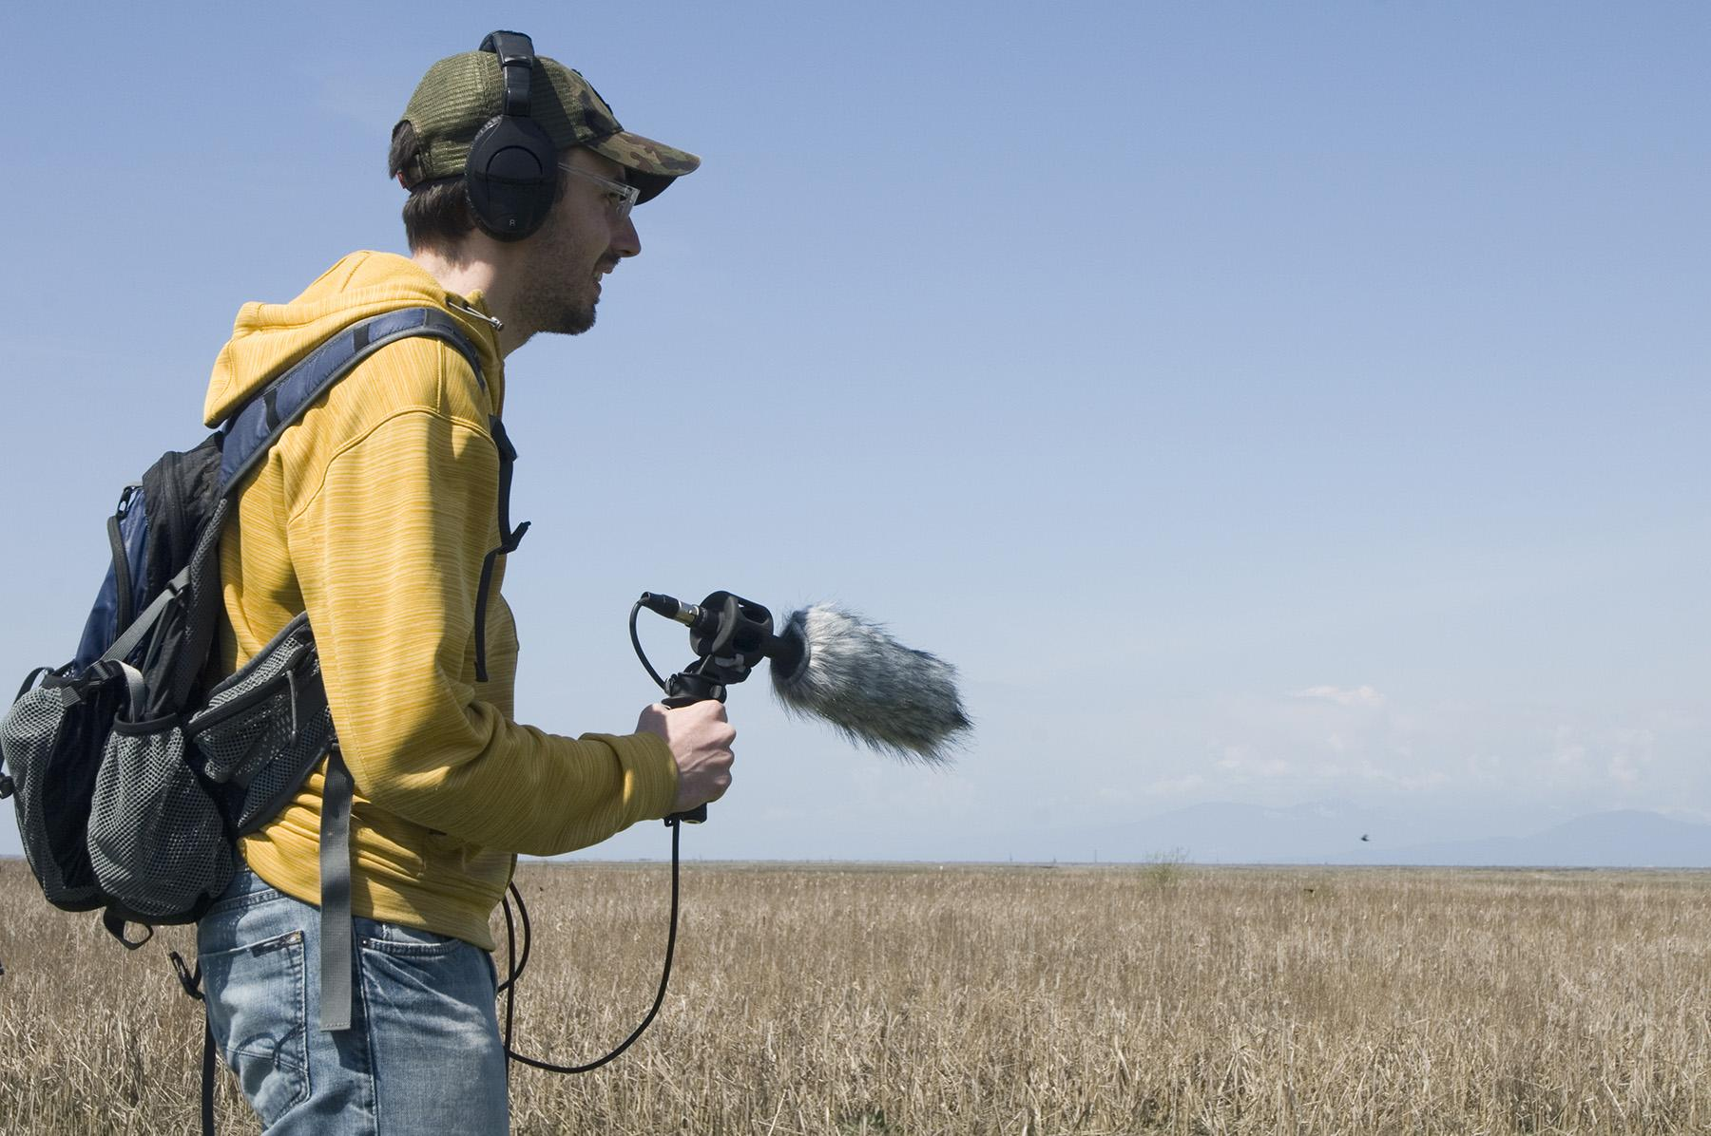
Use natural sound.

Slide 19
Respect
ownership.

Slide 20
Build a home online.

Slide 21
Promote like your life depended on it.

Slide 22
Have fun.
Have fun.

